Slide 1
CS4038
DATA MINING
LECTURE # 27
SPRING 2024
FAST – NUCES, CFD CAMPUS
Ayesha Liaqat
ayesha.liaqat@nu.edu.pk

Slide 2
TODAY’S TOPICS
Association Rule Mining
Apriori algorithm
Candidate generation and pruning
Rule generation

Slide 3
ILLUSTRATING APRIORI PRINCIPLE
 |  |  | TID | Items
 |  |  | 1 | Bread, Milk
 |  |  | 2 | Beer, B read, Diaper, Eggs
 |  |  | 3 | Beer, Coke, Diaper, Milk
 |  |  | 4 | Beer, B read, Diaper, Milk
 |  |  | 5 | Bread, Coke, Diaper, Milk
Items (1-itemsets)
Item | Count
Bread | 4
Coke | 2
Milk | 4
Beer | 3
Diaper | 4
Eggs | 1
Itemset | Count
{Bread,Milk} | 3
{Beer, Bread} 2
{Bread,Diaper} | 3
{Beer,Milk} 2
{Diaper,Milk} {Beer,Diaper} | 3 3
Pairs (2-itemsets)
Minimum Support = 3
Triplets (3-itemsets)
Itemset
Count
{ Beer, Diaper, Milk} 2
{ Beer,Bread, Diaper} 2
{Bread, Diaper, Milk}
2
{Beer, Bread, Milk}
1

Slide 4
APRIORI ALGORITHM
F_{k}: frequent k-itemsets
L_{k}: candidate k-itemsets
Join Step: C_{k} is generated by joining L_{k-1}with itself
Prune Step: Any (k-1)-itemset that is not frequent cannot be a subset of a frequent k-itemset
Algorithm
Let k=1
Generate F₁ = {frequent 1-itemsets}
Repeat until F_{k} is empty
Candidate Generation: Generate L_{k+1} from F_{k}
Candidate Pruning: Prune candidate itemsets in L_{k+1} containing subsets of length k that are infrequent
Support Counting: Count the support of each candidate in L_{k+1} by scanning the DB
Candidate Elimination: Eliminate candidates in L_{k+1} that are infrequent, leaving only those that are frequent => F_{k+1}

Slide 5
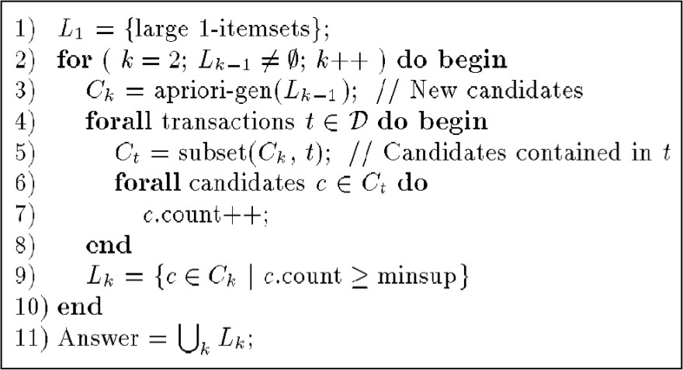
APRIORI ALGORITHM from AGARWAL et al. (1993)

Slide 6
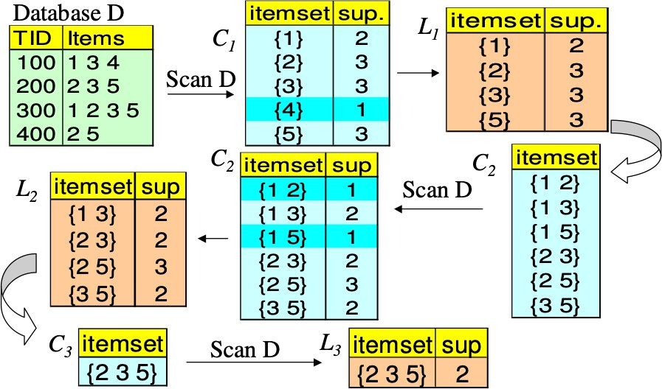
APRIORI ALGORITHM (EXAMPLE: s = 50%)

Slide 7
CANDIDATE GENERATION & PRUNING METHODS

Slide 8
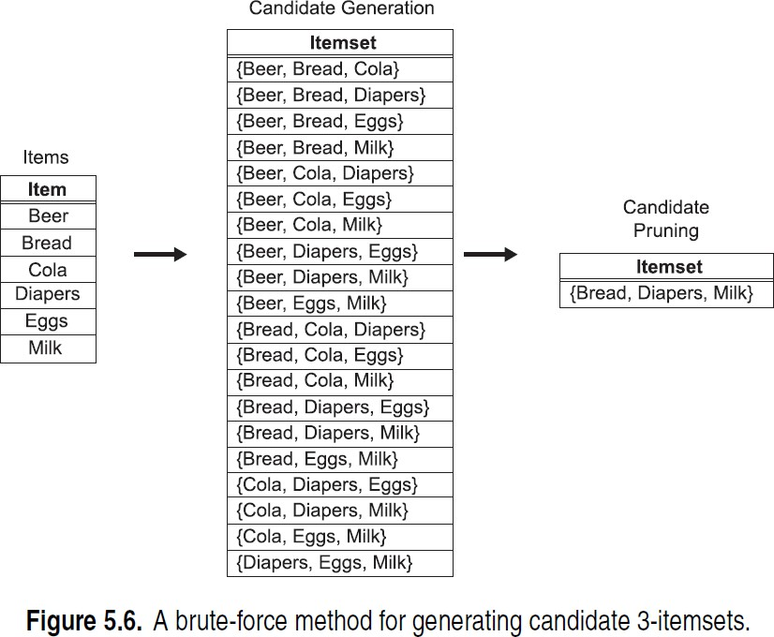
CANDIDATE GENERATION: BRUTE-FORCE METHOD
Every k-itemset is considered as a potential candidate, pruning is applied in the end to remove any unnecessary candidates
TID | Items
1 | Bread, Milk
2 | Beer, B read, Diaper, Eggs
3 | Beer, Coke, Diaper, Milk
4 | Beer, B read, Diaper, Milk
5 | Bread, Coke, Diaper, Milk

Slide 9
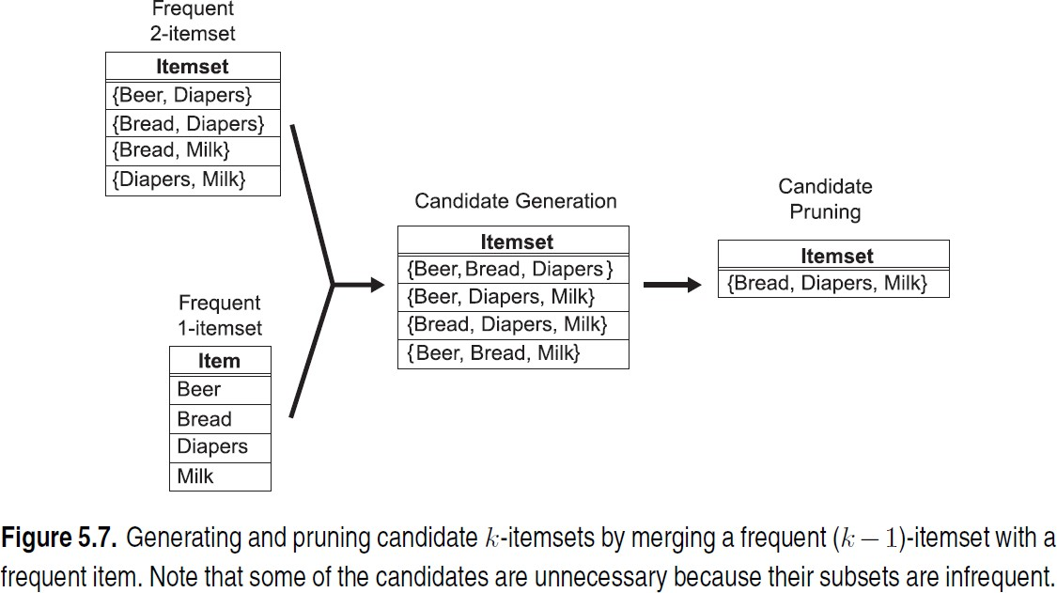
CANDIDATE GENERATION: MERGE Fk-1 x F1 METHOD
Extend each frequent (k-1)-itemset with other frequent items
Notes:
Merge, prune if subset not freq, support, repeat again for next steps

Slide 10
CANDIDATE GENERATION: F_{K-1} x F_{K-1} METHOD
Method used by Apriori algorithm
Merge two frequent (k-1)-itemsets if their first (k-2) items are identical
F₃ = {ABC,ABD,ABE,ACD,BCD,BDE,CDE}
Merge(ABC, ABD) = ABCD
Merge(ABC, ABE) = ABCE
Merge(ABD, ABE) = ABDE
Do not merge(ABD,ACD) because they share only prefix of length 1 instead of length 2

Slide 11
CANDIDATE PRUNING
Let F₃ = {ABC,ABD,ABE,ACD,BCD,BDE,CDE} be the set of frequent 3-itemsets
L₄ = {ABCD,ABCE,ABDE} is the set of candidate 4-itemsets generated (from previous slide)
Candidate pruning
Prune ABCE because ACE and BCE are infrequent
Prune ABDE because ADE is infrequent
After candidate pruning: L₄ = {ABCD}

Slide 12
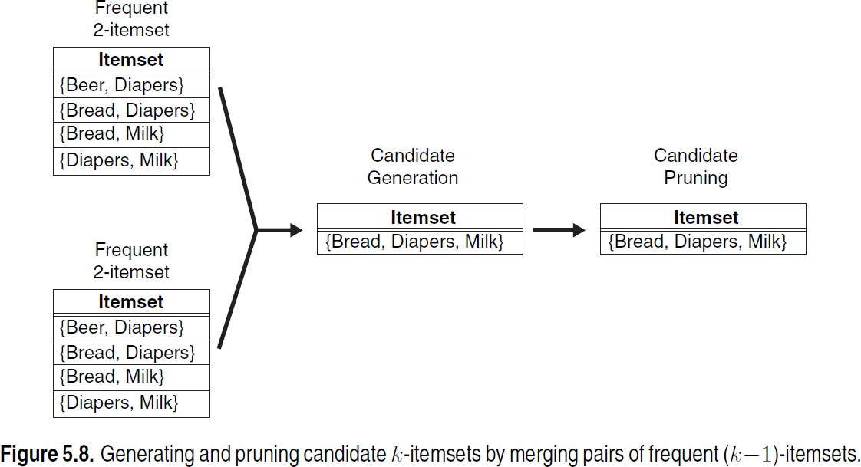
CANDIDATE GENERATION & PRUNING: F_{K-1} X F_{K-1} METHOD

Slide 13
ILLUSTRATING APRIORI PRINCIPLE
TID | Items
1 | Bread, Milk
2 | Beer, B read, Diaper, Eggs
3 | Beer, Coke, Diaper, Milk
4 | Beer, B read, Diaper, Milk
5 | Bread, Coke, Diaper, Milk
Item | Count
Bread | 4
Coke | 2
Milk | 4
Beer | 3
Diaper | 4
Eggs | 1
Items (1-itemsets)
Itemset | Count
{Bread,Milk} | 3
{Bread,Beer} 2
{Bread,Diaper} | 3
{Milk,Beer} 2
{Milk,Diaper} {Beer,Diaper} | 3 3
Pairs (2-itemsets)
Minimum Support = 3
Triplets (3-itemsets)
Itemset | Count
{ Beer, Diaper, Milk} { Beer,Bread, Diaper} | 2 2
{Bread, Diaper, Milk} | 2
{Beer, Bread, Milk} | 1

Slide 14
ILLUSTRATING APRIORI PRINCIPLE
Item | Count
Bread | 4
Coke | 2
Milk | 4
Beer | 3
Diaper | 4
Eggs | 1
Items (1-itemsets)
Itemset | Count
{Bread,Milk} | 3
{Bread,Beer} 2
{Bread,Diaper} | 3
{Milk,Beer} 2
{Milk,Diaper} {Beer,Diaper} | 3 3
Pairs (2-itemsets)
(No need to generate candidates involving Coke or Eggs)
Minimum Support = 3
Triplets (3-itemsets)
If every subset is considered,
⁶C₁ + ⁶C₂ + ⁶C₃
6 + 15 + 20 = 41
With support-based pruning, 6 + 6 + 1 = 13
Itemset
Count
{Bread, Diaper, Milk}
2
Use of F_{k-1}xF_{k-1} method for candidate generation results in only one 3-itemset. This is eliminated after the support counting
step.
68% reduction in the number of candidate itemsets in this simple example
14

Slide 15
ALTERNATE F_{K-1} X F_{K-1} METHOD
Merge two frequent (k-1)-itemsets if the last (k-2) items of the first one is identical to the first (k-2) items of the second.
F₃ = {ABC,ABD,ABE,ACD,BCD,BDE,CDE}
Merge(ABC, BCD) = ABCD
Merge(ABD, BDE) = ABDE
Merge(ACD, CDE) = ACDE
Merge(BCD, CDE) = BCDE

Slide 16
CANDIDATE PRUNING FOR ALTERNATE F_{K-1} X F_{K-1} METHOD
Let F₃ = {ABC,ABD,ABE,ACD,BCD,BDE,CDE} be the set of
frequent 3-itemsets
L₄ = {ABCD,ABDE,ACDE,BCDE} is the set of candidate 4- itemsets generated (from previous slide)
Candidate pruning
Prune ABDE because ADE is infrequent
Prune ACDE because ACE and ADE are infrequent
Prune BCDE because BCE
After candidate pruning: L₄ = {ABCD}

Slide 17
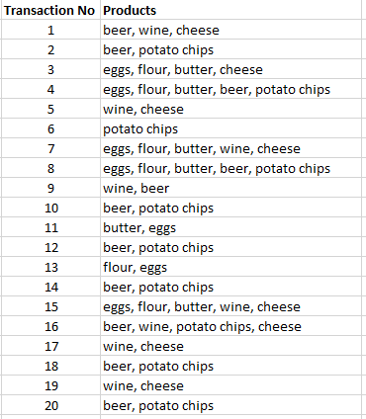
PRACTICE WORK
Find frequent itemsets for the given dataset.
Let’s suppose the support threshold is 7.
Following are the frequent itemsets
beer: 11
wine: 8
cheese: 8
potato chips: 10
eggs: 7
(cheese, wine): 7 (beer, potato chips): 9
https://towardsdatascience.com/the-apriori-algorithm-5da3db9aea95

Slide 18
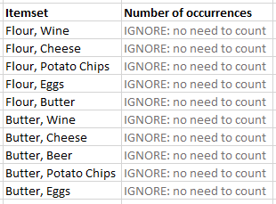
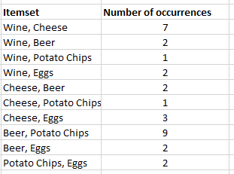
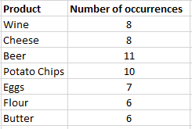
SOLUTION
Support count of 1-itemsets
These pairs will be ignored
Support count of 2-itemsets
What triplets can we make that do not contain any pair that was eliminated?

Slide 19
https://towardsdatascience.com/the-apriori-algorithm-5da3db9a SOLUTION
ea95
What triplets can we make that do not contain any pair that was eliminated?
Wine, Cheese, Beer -> eliminated because of the presence of a non-frequent pair (for example Cheese, Beer)
Wine, Cheese, Potato Chips -> eliminated because of the presence of a non-frequent pair (for example Cheese, Potato Chips)
Beer, Potato Chips,Wine -> eliminated because of the presence of a non-frequent pair (for example Wine, Potato Chips)
Cheese, Beer, Potato Chips -> eliminated because of the presence of a non-frequent pair (for example Cheese, Beer)
There are no triplets that do not contain any non-frequent pair.
Thus, identified frequent itemsets include:
(Wine, Cheese) and (Beer, Potato Chips)

Slide 20
CANDIDATE GENERATION METHODS
Brute force
◾
◾
Fk-1 x F1
Fk-1 x Fk-1
Alternating F_{k-1} x F_{k-1}

Slide 21
MINING ASSOCIATION RULES
Two-steps approach:
Frequent Itemset Generation
– Generate all itemsets whose support ≥ minsup
2.
Rule Generation
– Generate high confidence rules from each frequent itemset, where each rule is a binary partitioning of a frequent itemset

Slide 22
RULE GENERATION

Slide 23
RULE GENERATION
Given a frequent itemset L, find all non-empty subsets f ⊂ L such that f → L – f satisfies the minimum confidence requirement
If {A,B,C,D} is a frequent itemset, candidate rules:
ABC →D, ABD →C, ACD →B, BCD →A,
A →BCD, | B →ACD, | C →ABD, D →ABC
AB →CD, BD →AC, | AC → BD, CD →AB, | AD → BC, BC →AD,
If |L| = k, then there are 2^{k} – 2 candidate association rules (ignoring L → ∅ and ∅ → L)

Slide 24
DEFINITION: ASSOCIATION RULE
Association Rule An implication expression of the form X → Y, where X and Y are itemsets Example: {Milk, Diaper} → {Beer} |  | TID |  | Items
 |  | 1 |  | Bread, Milk
 |  | 2 |  | Bread, Diaper, Beer, Eggs
 |  | 3 |  | Milk, Diaper, Beer, Coke
 |  | 4 |  | Bread, Milk, Diaper, Beer
 |  | 5 |  | Bread, Milk, Diaper, Coke
Rule Evaluation Metrics
Example:
{Milk, Diaper} ⇒ {Beer}
•
Support (s)
Fraction of transactions that contain both X and Y
_{s =} σ (Milk, Diaper,Beer) ₌ 2 _{= 0.4}
| T | 5
_{c =} σ (Milk, Diaper,Beer) ₌ 2 _{= 0.67}
•
Confidence (c)
Measures how often items in Y appear in transactions that contain X
σ (Milk, Diaper) 3

Slide 25
MINING ASSOCIATION RULES
Recall this example and our observations
Example of Rules:
{Milk,Diaper} → {Beer} (s=0.4, c=0.67)
{Milk,Beer} → {Diaper} (s=0.4, c=1.0)
{Diaper,Beer} → {Milk} (s=0.4, c=0.67)
{Beer} → {Milk,Diaper} (s=0.4, c=0.67)
{Diaper} → {Milk,Beer} (s=0.4, c=0.5)
{Milk} → {Diaper,Beer} (s=0.4, c=0.5)
TID | Items
1 | Bread, Milk
2 | Bread, Diaper, Beer, Eggs
3 | Milk, Diaper, Beer, Coke
4 | Bread, Milk, Diaper, Beer
5 | Bread, Milk, Diaper, Coke
Observations:
All the above rules are binary partitions of the same itemset:
{Milk, Diaper, Beer}
Rules originating from the same itemset have identical support but can have different confidence
Thus, we may decouple the support and confidence requirements

Slide 26
RULE GENERATION
In general,
confidence does not have an anti-monotone property
c(ABC →D) can be larger or smaller than c(AB →D)
But confidence of rules generated from the same itemset has an anti-monotone property
E.g., Suppose {A,B,C,D} is a frequent 4-itemset:
c(ABC → D) ≥ c(AB → CD) ≥ c(A → BCD)
◾
Confidence is anti-monotone w.r.t. number of items on the RHS of the rule

Slide 27
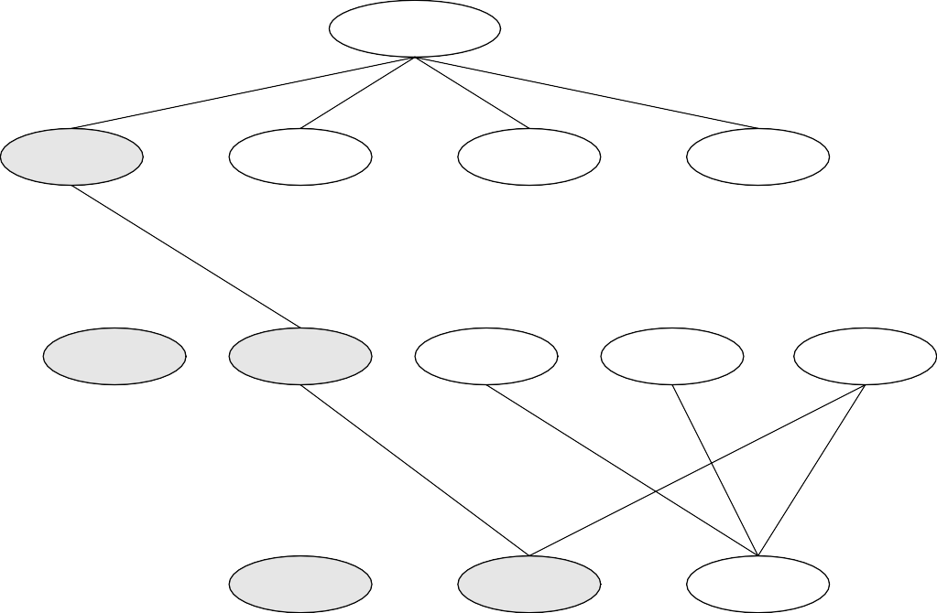
Lattice of rules
RULE GENERATION FOR APRIORI ALGORITHM
Low Confidenc
ABCD=>{ }
e Rule
BCD=>A
ACD=>B
ABD=>C
ABC=>D
CD=>AB
BD=>AC
BC=>AD
AD=>BC
AC=>BD
AB=>CD
Pruned Rules
D=>ABC
C=>ABD
B=>ACD
A=>BCD

Slide 28
SUMMARY: MINING ASSOCIATION RULES

Slide 29
MINING ASSOCIATION RULES
Two-step approach:
Frequent Itemset Generation
Generate all itemsets whose support ≥ minsup
Rule Generation
Generate high confidence rules from each frequent itemset, where each rule is a binary partitioning of a frequent itemset

Slide 30
FACTORS AFFECTING COMPLEXITY OF APRIORI ALGORITHM
Choice of minimum support threshold
Dimensionality (number of items) of the data set
Transactions
List of Candidates
Size of database
TID | Items
1 | Bread, Milk
2 | Bread, Diaper, Beer, Eggs
3 | Milk, Diaper, Beer, Coke
4 | Bread, Milk, Diaper, Beer
5 | Bread, Milk, Diaper, Coke
N
M
Average transaction width
w

Slide 31
FACTORS AFFECTING COMPLEXITY OF APRIORI ALGORITHM
Choice of minimum support threshold
lowering support threshold results in more frequent itemsets
this may increase number of candidates and max length of frequent itemsets
Dimensionality (number of items) of the data set
Size of database
Average transaction width
TID | Items
1 | Bread, Milk
2 | Beer, B read, Diaper, Eggs
3 | Beer, Coke, Diaper, Milk
4 | Beer, B read, Diaper, Milk
5 | Bread, Coke, Diaper, Milk

Slide 32
IMPACT OF SUPPORT BASED PRUNING
TID | Items
1 | Bread, Milk
2 | Beer, B read, Diaper, Eggs
3 | Beer, Coke, Diaper, Milk
4 | Beer, B read, Diaper, Milk
5 | Bread, Coke, Diaper, Milk
Item | Count
Bread | 4
Coke | 2
Milk | 4
Beer | 3
Diaper | 4
Eggs | 1
Items (1-itemsets)
Minimum Support = 3
Minimum Support = 2
If every subset is considered,
⁶C₁ + ⁶C₂ + ⁶C₃
6 + 15 + 20 = 41
With support-based pruning, 6 + 6 + 4 = 16
If every subset is considered,
⁶C₁ + ⁶C₂ + ⁶C₃ + ⁶C₄
6 + 15 + 20 +15 = 56

Slide 33
FACTORS AFFECTING COMPLEXITY OF APRIORI ALGORITHM
Choice of minimum support threshold
Dimensionality (number of items) of the data set
More space is needed to store support count of itemsets
if number of frequent itemsets also increases, both computation and I/O costs may also increase
Size of database
Average transaction width

Slide 34
FACTORS AFFECTING COMPLEXITY OF APRIORI ALGORITHM
Choice of minimum support threshold
Dimensionality (number of items) of the data set
Size of database
run time of algorithm increases with number of transactions
Average transaction width

Slide 35
FACTORS AFFECTING COMPLEXITY OF APRIORI ALGORITHM
Choice of minimum support threshold
Dimensionality (number of items) of the data set
Size of database
Average transaction width
For dense data sets, average transaction width can be very large.
This can increase the maximum size of frequent itemsets.
More itemsets are contained in the transactions.

Slide 36
APPLICATIONS OF APRIORI ALGORITHM
In Education Field: Extracting association rules in data mining of admitted students through characteristics and specialties.
In Medical field: For example Analysis of the patient's database.
In Forestry: Analysis of probability and intensity of forest fire with the forest fire data.
Apriori is used by many companies like Amazon in the Recommender System and by Google for the auto-complete feature.
Notes:
recruitment, program development, and student support services
risk factors, optimizing treatment protocols, and improving patient care.
Weather conditions, human activities

Slide 37
REFERENCES
Chapter 6:Tan, Steinbach & Kumar
Chapter 6: Han, Kamber & Pei

